Slide 1
Performance Testing with AWS X-Ray, CloudWatch, and RDS performance tools
Daniel Kranowski
Business Algorithms, LLC
www.bizalgo.com
PNSQC 2019

Slide 2
AWS performance tools
X-Ray
CloudWatch
Logs
Metrics
RDS
Enhanced Monitoring
Performance Insights

Slide 3
Example system under test
ECS
Kinesis
Lambda
RDS
Message producer
Docker app
Message queue
Asynchronous
Message consumer
Serverless app
Database
https://github.com/daniel-kranowski/aws-perfmon-01
ECS: Elastic Container Service
RDS: Relational Database Service

Slide 4
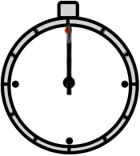
Example performance test deliverables
ECS
Kinesis
Lambda
RDS
Propagation delay: system
Bottlenecks: each service

Slide 5
Measuring async prop delay is hard
our laptop clock
ECS
clock
Lambda
clock
highly skewed propagation delay
start
finish
diff
12:00:00 11:59:50 12:01:00
12:00:02 11:59:52 12:01:02
0:00:02 0:00:02 0:00:02 0:01:12
...the ideal measurement would use a single clock.

Slide 6
AWS X-Ray

Slide 7
What is AWS X-Ray?
X-Ray
Timing capture and analysis
Traces, segments, services
Segment uploader
Sampling
Synchronous

Slide 8
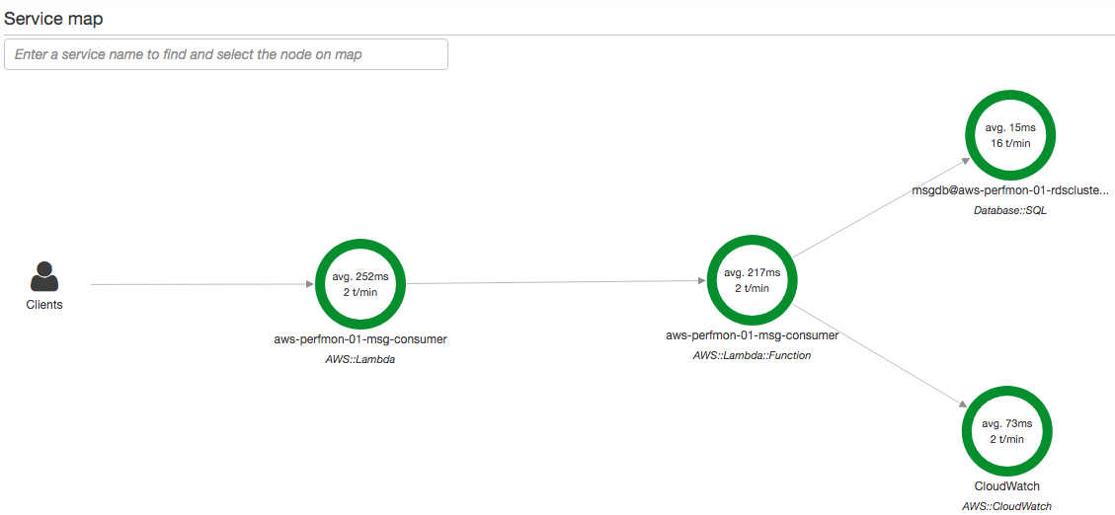
X-Ray

Slide 9
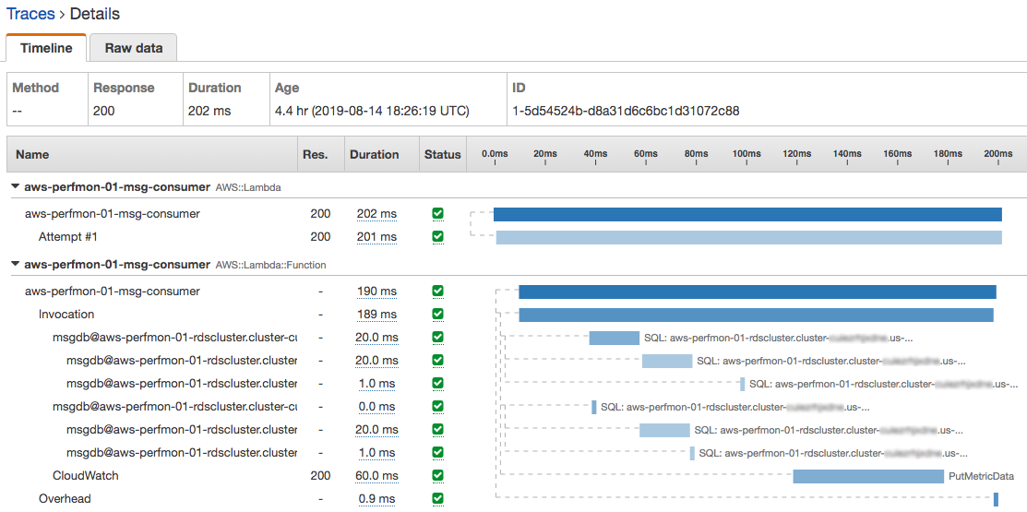
X-Ray
Duration = (end_time – start_time)

Slide 10
Instrumenting NodeJS Lambda for X-Ray
X-Ray
TypeScript
import * as AWS from 'aws-sdk';
import * as AWSXRayCore from 'aws-xray-sdk-core';
AWSXRayCore.captureAWS(AWS);
// AWS object is now instrumented for X-Ray.
export async function handler(event, content) { ..... }
Terraform
resource "aws_lambda_function" "lambdaFunction" {
tracing_config {
mode = "Active"
}
.....
}

Slide 11
X-Ray
Limitation:
X-Ray does not trace across Kinesis

Slide 12
Asynchronous
RDS
X-Ray
ECS
Kinesis
Lambda
PUT
GET
X-Ray trace #1
(if instrumented)
sees ECS app and Kinesis PUT.
Cannot be instrumented with X-Ray to measure time between PUT and GET.
X-Ray trace #2
sees Lambda
and RDS. Does not see Kinesis.

Slide 13
Asynchronous
RDS
X-Ray
ECS
Kinesis
Lambda
PUT
GET
...No single propagation delay for the whole system.
...and the clocks may be skewed anyway.

Slide 14
AWS CloudWatch
Logs
Metrics

Slide 15
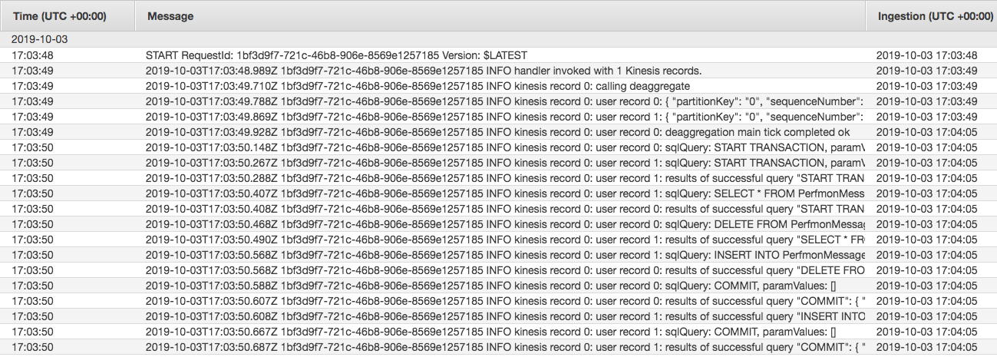
Logs for performance measurement?
CloudWatch
Reference API OutputLogEvent:
timestamp: Set by CloudWatch client (unregulated skew)
ingestionTime: Set by CloudWatch service (one clock: no skew)
Search isn't easy. But could Logs solve the clock problem?

Slide 16
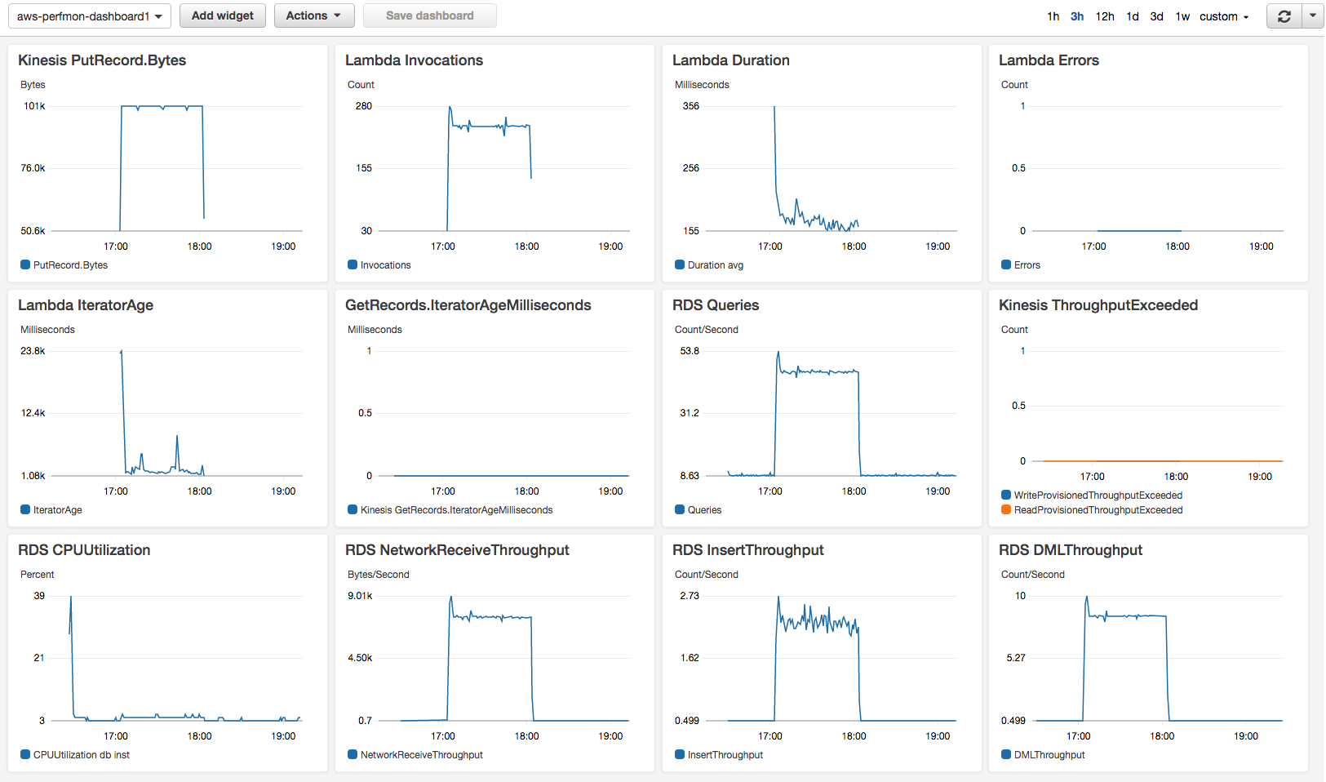
standard service Metrics
CloudWatch

Slide 17
what CloudWatch Metrics does well
CloudWatch
Configurable axes and labels
Precise historical time window
Multiple metrics per graph
Math functions
Always capturing data
Alarms integration
...RDS-EM/PI graphing tools are not as good.

Slide 18
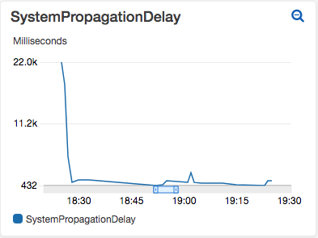
custom Metric
CloudWatch
Clock skew between ECS and Lambda is initially 22 sec
Clock skew goes to zero after Lambda clock is synchronized
Prop delay = (Lambda end time) – (ECS start time)

Slide 19
custom Metric: Lambda code
CloudWatch
TypeScript
import {AWSError} from 'aws-sdk';
import * as CloudWatch from 'aws-sdk/clients/cloudwatch';
const cloudwatch = new CloudWatch();
const now: Date = new Date();
const propDelay: number = now.getTime() – ecsStartTime;
cloudwatch.putMetricData(
{
MetricData: [
{
MetricName: 'SystemPropagationDelay',
Timestamp: now,
Unit: 'Milliseconds',
Value: propDelay,
}
],
Namespace: 'my-namespace',
})
.promise()
.catch((err: AWSError) => console.log('Error',
JSON.stringify(err)));

Slide 20
AWS RDS
Enhanced Monitoring
Performance Insights

Slide 21
Enabling RDS-EM/PI features
RDS
Use a supported DB version and instance type.
Configure at startup, or do a reboot.
Amazon Aurora

Slide 22
RDS-EM: more granular OS metrics
RDS
DB
JSON snapshot every 1, 5, 10, 15, 30, or 60 seconds
RDS virtual machine
Operating System metrics
Linux process list
CloudWatch Logs: RDSOSMetrics
Log Group

Slide 23
RDS-EM: more granular OS metrics
RDS
Standard RDS metrics | RDS-EM metrics
CPUUtilization | cpuUtilization.guest
 | cpuUtilization.idle
 | cpuUtilization.irq
 | cpuUtilization.nice
 | cpuUtilization.user
 | cpuUtilization.wait
FreeableMemory | memory.free
 | memory.active
 | memory.cached
 | memory.hugePagesFree
 | memory.mapped
etc....

Slide 24
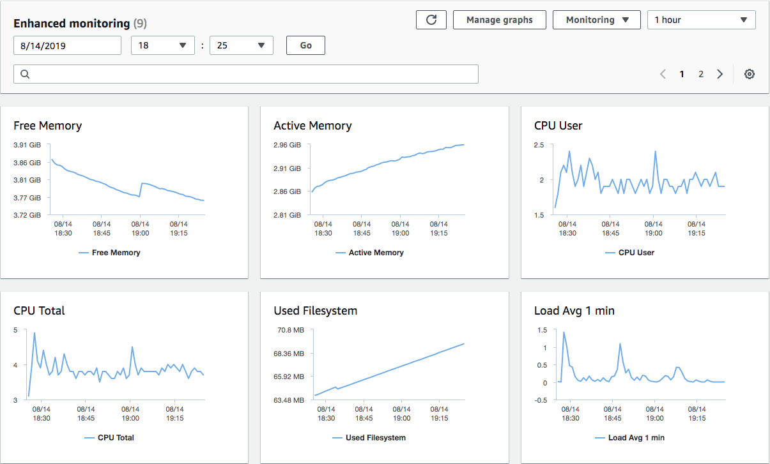
RDS-EM: more granular OS metrics
RDS

Slide 25
RDS
Limitation:
Not integrated with CloudWatch Metrics

Slide 26
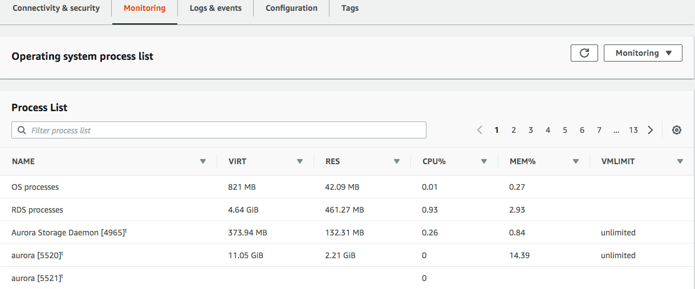
RDS-EM: OS process list
RDS

Slide 27
RDS-PI features
RDS
Numeric counters
OS level (like RDS-EM) + DB specific
CloudWatch Metric
DBLoad (number of active db sessions)
Dimension keys and resource metrics
Average Active Sessions (AAS) chart ★★★

Slide 28
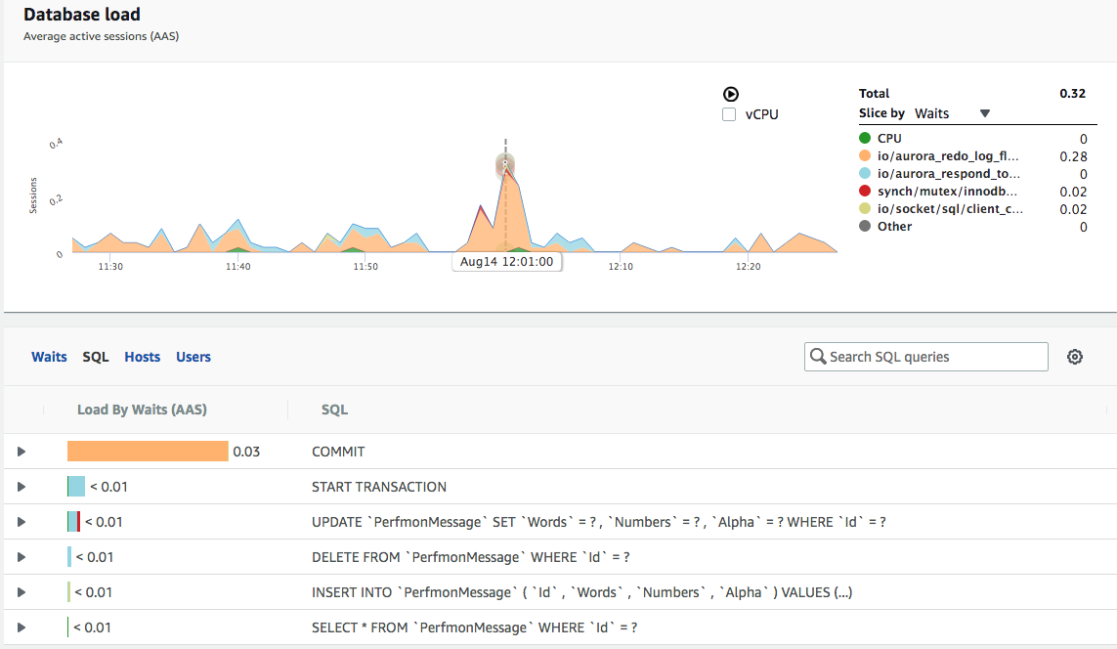
RDS-PI: AAS chart
RDS

Slide 29
RDS-PI: AAS chart
RDS
DBLoad = 0.32
0.32 database sessions during 12:01:00 – 12:01:59.
Could be:
2 clients concurrently for 9.6 sec: 2 x 9.6 / 60 = 0.32
Client #1 for 10 sec, then client #2 for 9.2 sec
etc

Slide 30
RDS-PI: AAS chart
RDS
io/aurora_redo_log_flush = 0.28
Most of the db session time is waiting for Aurora write I/O.
https://docs.aws.amazon.com/AmazonRDS/latest/AuroraUserGuide/AuroraMySQL.Reference.html

Slide 31
RDS-PI: AAS chart
RDS
Group-by dimension: Waits
Dimension choices: Waits, SQL, Hosts, Users

Slide 32
RDS-PI: AAS chart
RDS
Partition-by dimension: SQL

Slide 33
RDS-PI: AAS chart
RDS
DBLoad = 0.03
0.03 database sessions during 11:25:00 – 12:25:59.
Could be:
2 clients concurrently for 0.9 sec: 2 x 0.9 / 60 = 0.03

Slide 34
limits of RDS-PI
RDS
2-D model is incompatible with CloudWatch Metrics
RDS-PI lacks alarms; zoom is imprecise; etc
Highlights problems with high DBLoad, even if root cause is small DBLoad
A few bad user sessions stalling the db
Cannot slice by other indicators
CPU, memory, network throughput, etc

Slide 35
Summary
Clock skew in an asynchronous system
AWS X-Ray
Sampled synchronous timing
AWS CloudWatch
Logs ingestionTime: one single clock
Metrics: strong UI/API; custom metrics
AWS RDS
RDS-EM: granular OS metrics
RDS-PI: 2-D AAS chart

Slide 36
additional information
Technical paper (PDF) related to this presentation:
https://www.pnsqc.org/daniel-kranowski/
Code for the example system under test:
https://github.com/daniel-kranowski/aws-perfmon-01
Contact the author:
www.bizalgo.com/contact

